Slide 1



Senior Project: Mixed Reviews
Single Page
Single Page
OR
“This place is a bit of a mixed bag”
Naveen K
SWE / CS - Cogswell College

Slide 2
Project Summary
Look at reviews of businesses from sites such as Yelp, Foursquare, Google Places, etc.
Allow users to filter out reviews by rating, or by site name (ie. Show all 5 star reviews of a particular restaurant only from yelp.com)

Slide 3

What problem am I solving?
Users these days are having to go to different review sites to get reviews on a particular type of business, for example, restaurants and travel related businesses. For every type of business, there are multiple review sites. It’s difficult for users to filter through all the reviews and collate them to come to a conclusion on a business.
This program solves that problem. Users can search across different review sites and have the results display on a single page.

Slide 4
Functionality
BAD!! MULTIPLE TABS ARE A NO NO!!
User can search for what reviews they want similar from sites such as Yelp, Foursquare, Google Places. The user can filter firsthand what they want to see, including ratings, price range, distance. The web page will display the results based on the user’s criteria
The program will also store their search history, as well as the results from the web page into a database
This program will run as a Java application, and the results will appear on a web browser
While some may feel that seeing reviews from different sites in one page may be too much, that’s where they can apply filters to show them what they really want.

Slide 5

Objectives
The user will enter a search criteria for what they choose to search for. The user can choose to filter their results based on their desired criteria such as rating, price range, or distance BEFORE the search begins.
Behind the scenes, the program will get the data from the internet using REST API calls for different review sites, such as Google Places, Yelp, etc.
The data be split into different pages to ensure simplicity for a better user experience. There will be about 10-15 results per page. User will click the next button and it will fetch another 10-15 results.

Slide 6

Target audience
The target audience is people who are pressed for time and they want to quickly review something from different sites. This prevents them from having to have multiple tabs in their browser open.
Another possible target audience is people who are lazy. These people won’t want to put any effort to switch from tab for their review results.

Slide 7
Documents for the project
Updated Requirements Document
https://docs.google.com/document/d/16Ex_xJRFh51glrJ8xOBPaXZ8VYMgwdZBvzy5JISX4n4/edit
Design Document
https://docs.google.com/document/d/1YtHPuhnSbPihQi1PezYEPE4Rr3EJTBOrHpvMi7V6nv4/edit

Slide 8
Tech Stack
Java Version 8 Update 151 Build 1.8.0_151-b12
HTML5
CSS 3
JavaFX Version 8
JDBC Version 5.1.44
MySQL Community Server 5.7.19
Development Environment
Eclipse Oxygen Release (4.7.0)
Mac OS X 10.12.6
MySQL Workbench 6.3
Postman 5.3.2

Slide 9
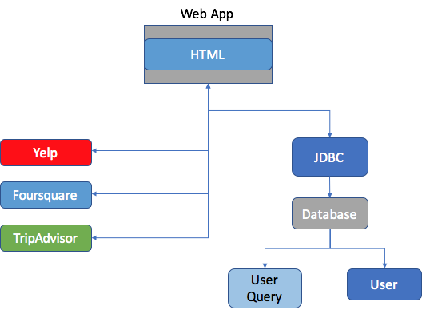
System Diagram
Web App
Google Places

Slide 10
Summary of Use Cases: Most important ones
User wants to search for the nearest restaurant
1.) User enters the name of restaurant in the search bar, chooses to search within a 5 mile radius of their current location, San Jose, CA
2.) Chooses to show only 5 star reviews from Yelp and Foursquare
3.) Clicks the search button, and the webpage automatically opens, displaying the results

Slide 11
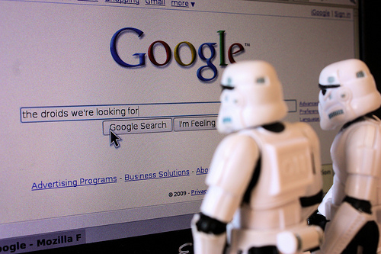
What has been achieved so far?
UI implementation has been completed using JavaFX
Write the DAO interface using Java JDBC with MySQL
Note: still need to work on linking tables. Make one of the attributes of both tables a foreign key
Design Document / Requirements Doc
Research the review sites that I plan to use (Yelp, Google Places)
Foursquare and Tripadvisor still being determined

Slide 12
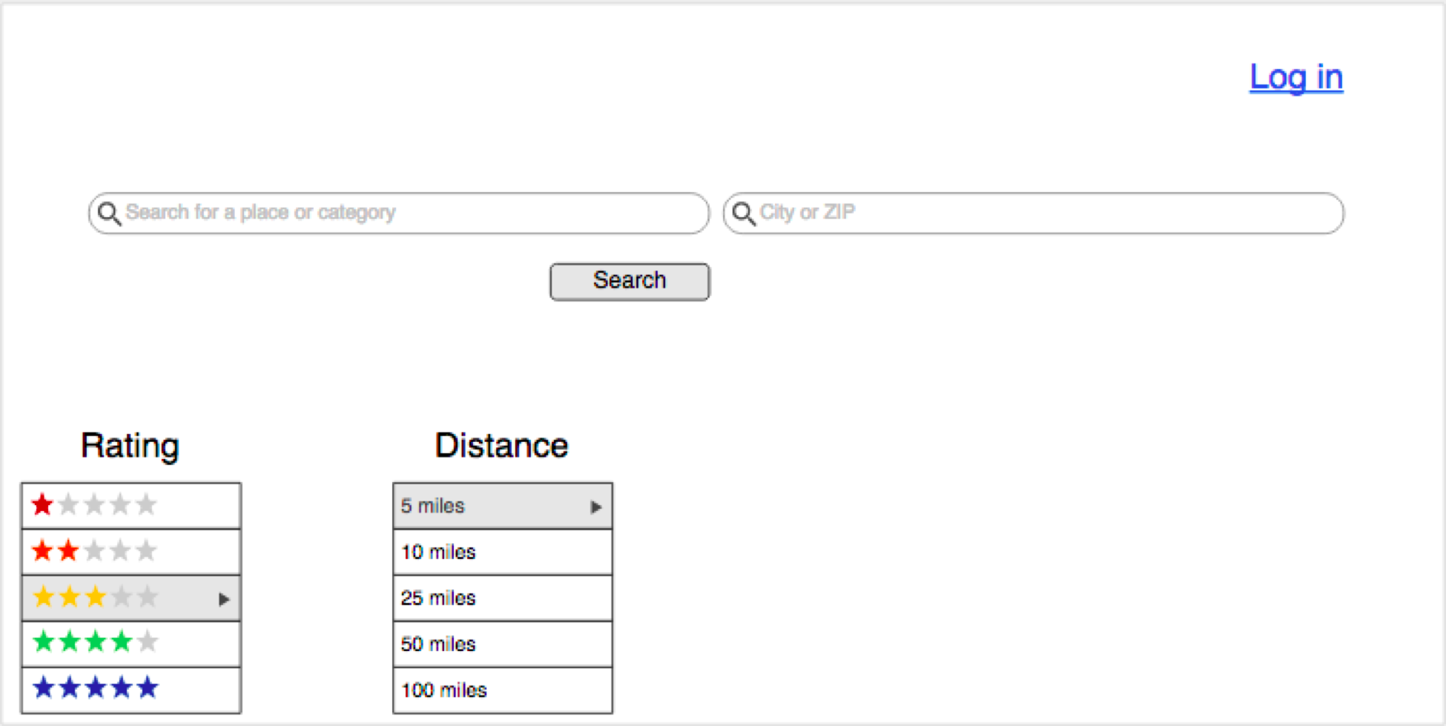
Proof of Concept for the UI
You may notice that some components of the UI may be missing. Fortunately, I have addressed it in my final UI.

Slide 13
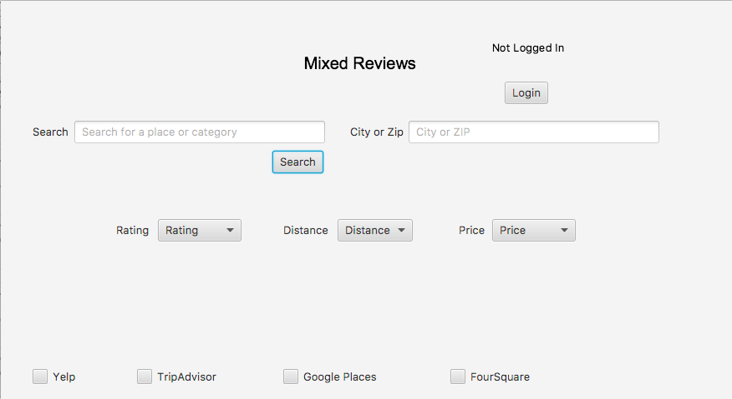
The UI I have implemented so far

Slide 14
What are the remaining tasks to complete?
Build the HTML webpage skeleton for the web page
MOST IMPORTANT
Work on making API calls. (Will spend break doing that)

Slide 15

Questions?

